Slide 1

Phase-XIII Identifying the similar attempts on the same dataset or Similar Research Questions Training / Inference in noisy environments and incomplete data
Guided by: Dr. Sabah Mohammed
Mohan Prasad Kutala
mkutala@lakeheadu.ca

Slide 2
Paper Name: A Spatial Median Filter for Noise Removal in Digital Images
They tested digital images on six different noise removal filters
Mean and Median
The worst performing filter of the six tests was the Mean filter. For all noise compositions containing at least p = 0.10 noise, it produced the least accurate results.
The most stable of the filters was the Component Median Filter, which had the best accuracy across all eleven tested noise compositions. For noise compositions containing p<=0.15
Paper Name: Performance Analysis of Image Smoothing Methods for Low Level of Distortion
conservative smoothing technique is best method among different image smoothing techniques to reduce the blur in an image.
This method is superior to other filters like mean and median filters in terms of its higher capability to preserve the detailed information in an image

Slide 3
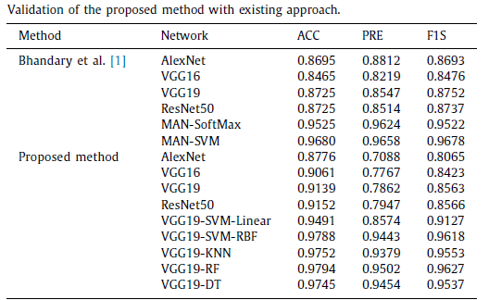
Paper Name: Customized VGG19 Architecture for Pneumonia Detection in Chest X-Rays
The results confirmed that, VGG19 provides better classification accuracy (97%) compared to other methods
https://www.kaggle.com/paultimothymooney/chest-xray-pneumonia

Slide 4
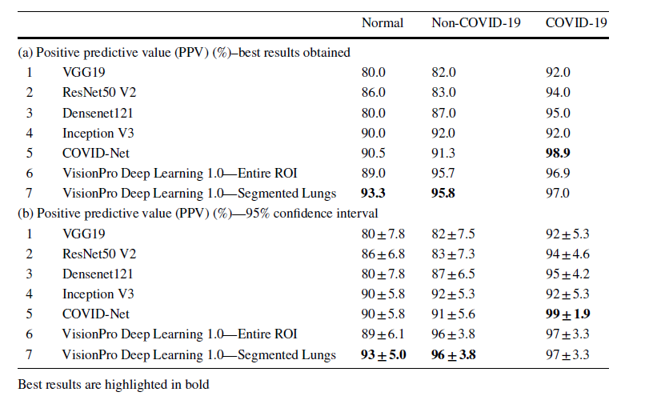
Paper Name: Identification of Images of COVID‑19 from Chest X‑rays Using Deep Learning
In this paper, they worked on different deep learning techniques such as ResNet, DenseNet, VGG19, vision pro etc

Slide 5
Paper Name: TorchXRayVision: A Library of chest x-ray datasets and models
TorchXrayVision to deduct the ratio difference between two lungs using x-Rays.
Used RALO dataset (https://zenodo.org/record/4634000#.YX2YGp7MJPY)
TorchXRayVision is an open source software library for working with chest X-ray datasets and deep learning models. It provides a common interface and common pre-processing chain for a wide set of publicly available chest X-ray datasets
Paper Name:
Paul M (2020) Kaggle chest X-ray images (pneumonia) dataset
This is collection of Pneumonia images in which few members are working on the same dataset to deduct the pneumonia using different algorithms like resnet and denseNet etc., Few of them are still working on it

Slide 6
Paper Name: A New Approach for Classifying Coronavirus COVID-19 Based on Its Manifestation on Chest x-Rays Using Texture Features and Neural Networks
develop the system to auto detect the covid-19 positive cases such that they selected few different methods in each level and tested the dataset against the model.
Convolutional Neural Network with a classification accuracy of 83.02% and a superior AUC of 0.907, which would mean a better ability to detect the COVID19 using this method.
100% accuracy on the validation set using the feed-forward neural network, and this is using as inputs the flattened image and the texture features

Slide 7


